Slide 1
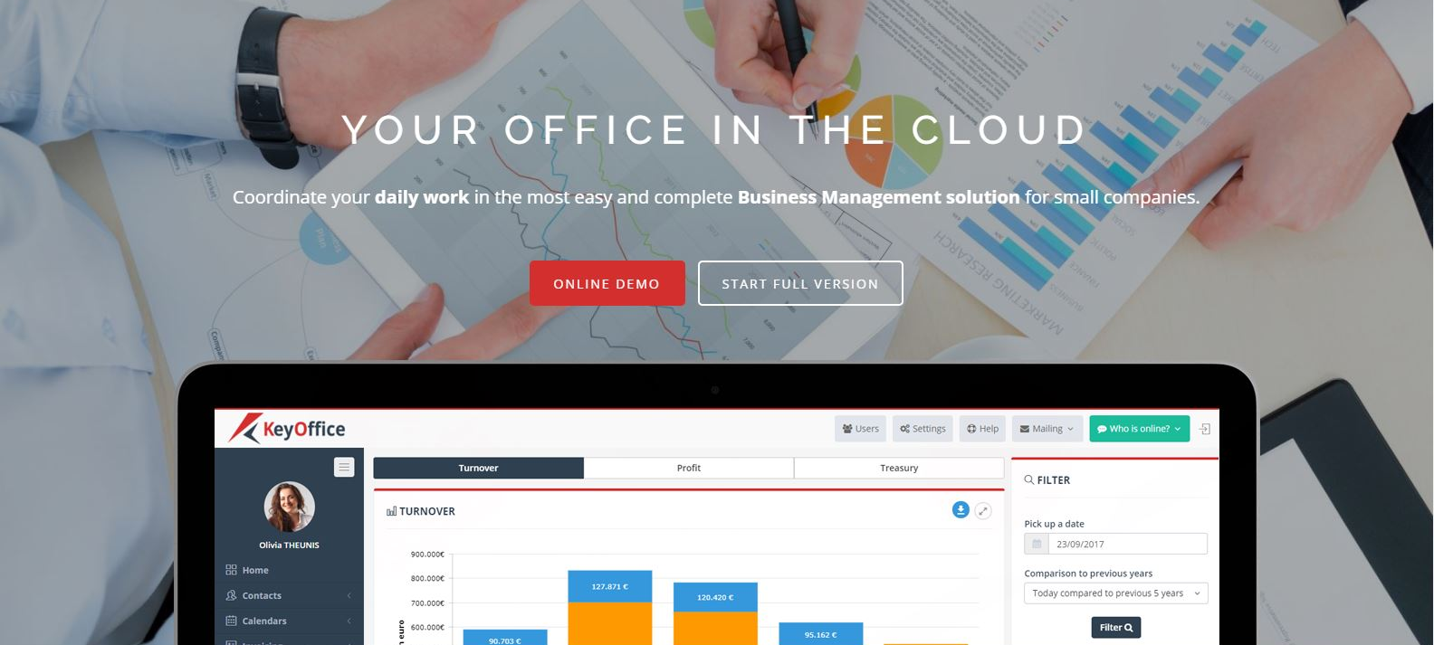
WWW.KEYOFFICE.CLOUD
Make your business available from anywhere at any time

Slide 2
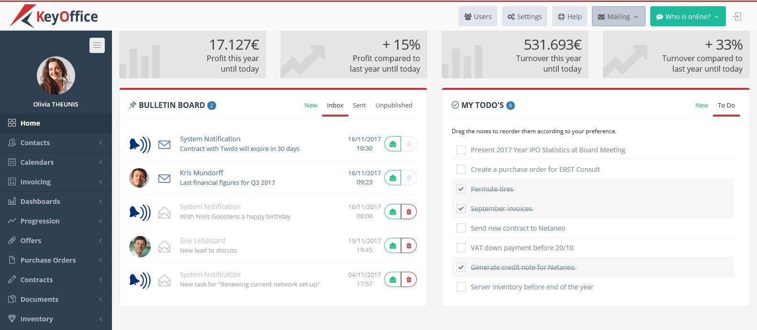
Follow-up your daily work and To Do’s
TASKS AND AUTOMATED REMINDERS

Slide 3
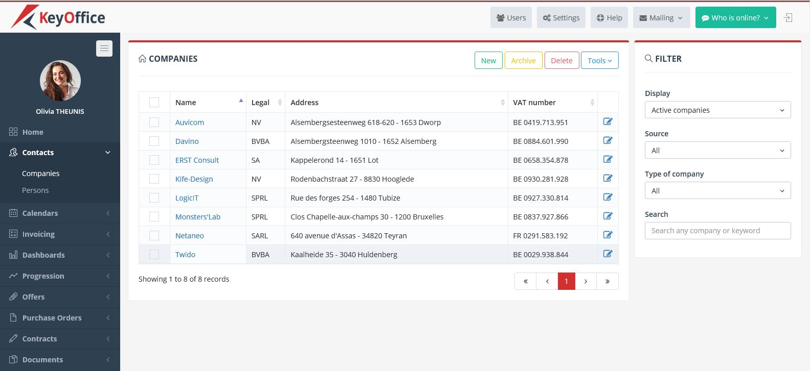
Keep track of all your contact’s information
CRM
NEVER LOSE IMPORTANT DATA ANYMORE

Slide 4
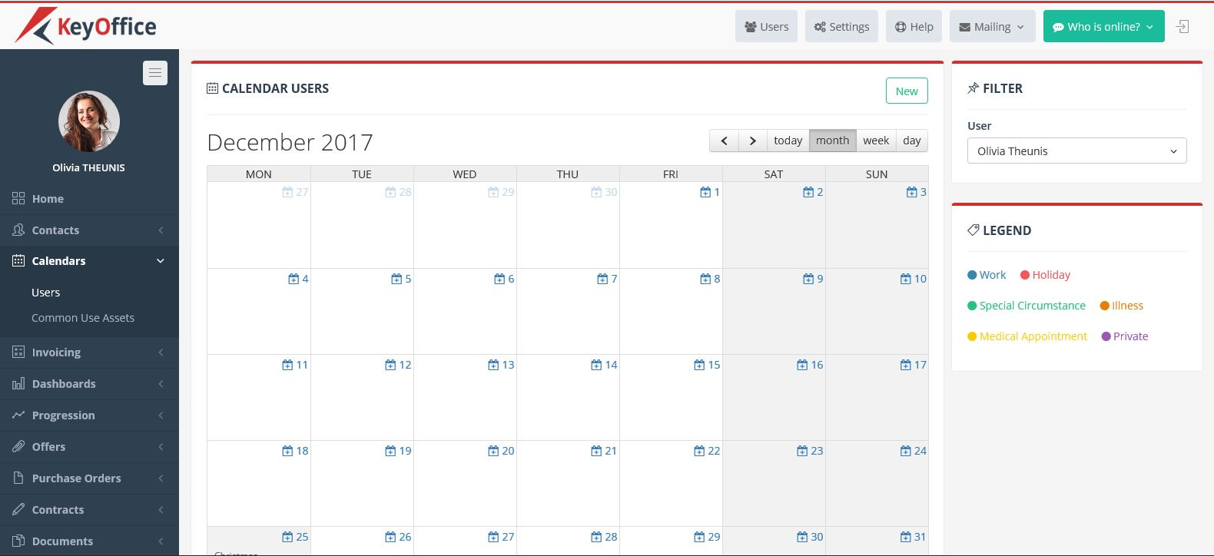
Plan events based on availabilities
SHARED CALENDARS
SHARE YOUR PLANNING WITH YOUR COLLEAGUES

Slide 5
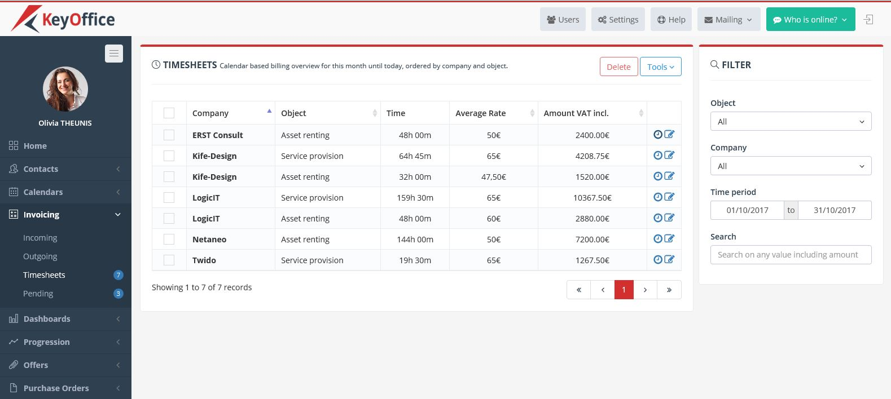
Track time for provided services
TIMESHEETS and automatic invoicing

Slide 6
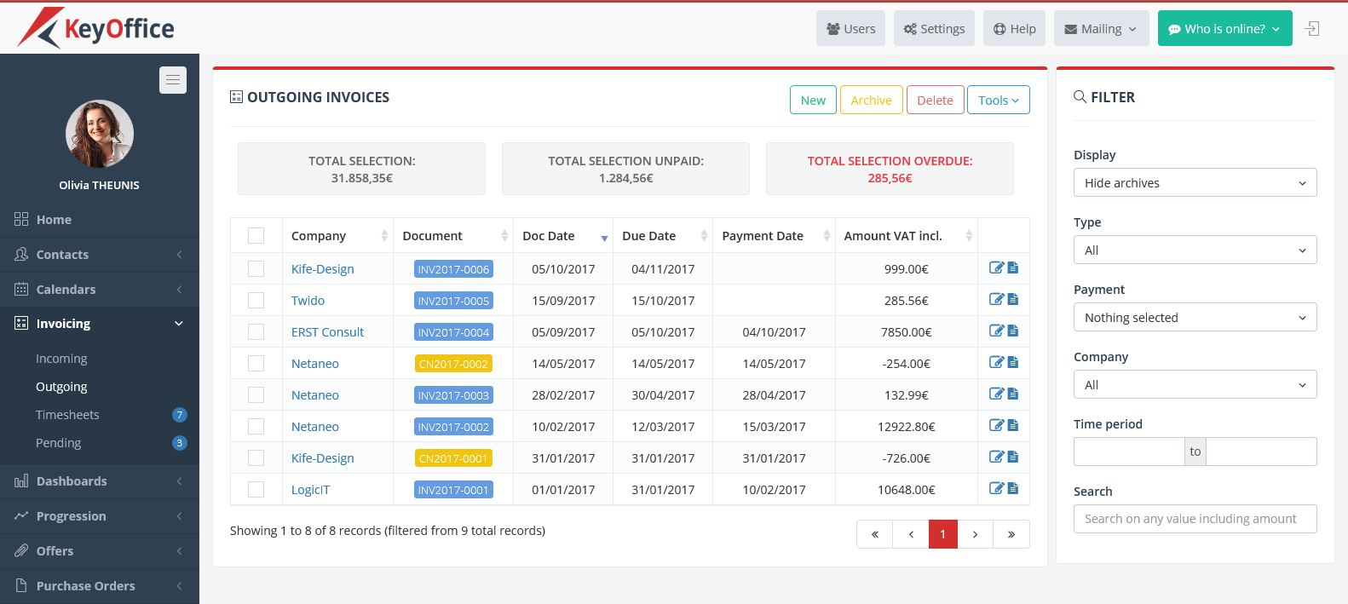
Generate your invoices and follow-up payments
Create an invoice has never been so easy!

Slide 7
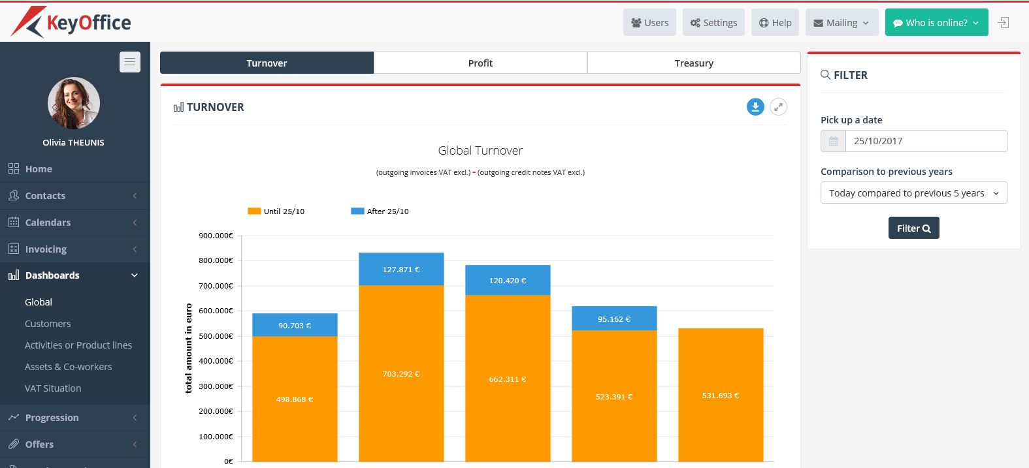
Compare results with previous years or monthes
FINANCIAL DASHBOARDS

Slide 8
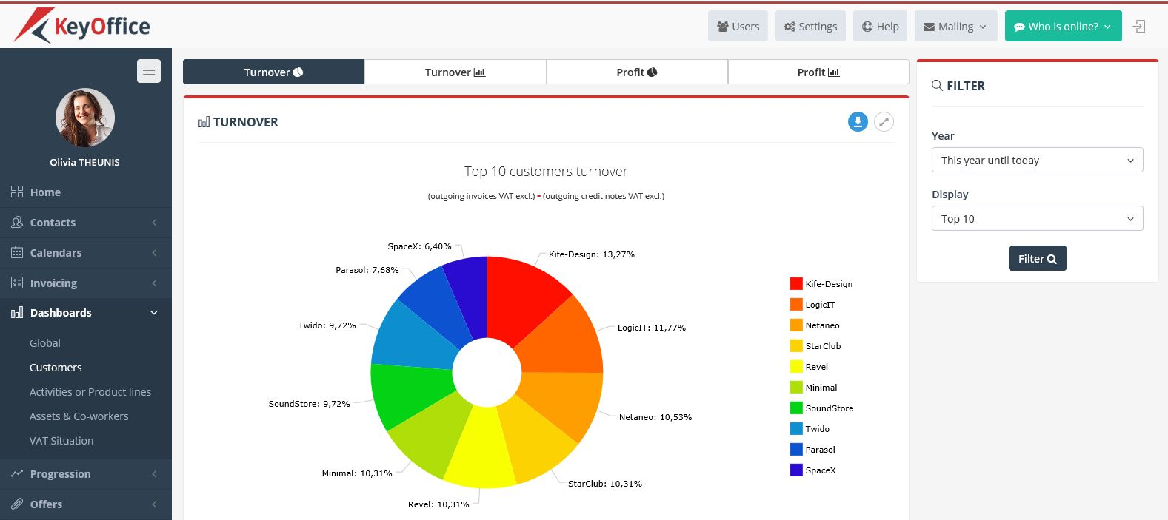
Rate your customers by turnover and profit
FINANCIAL DASHBOARDS

Slide 9
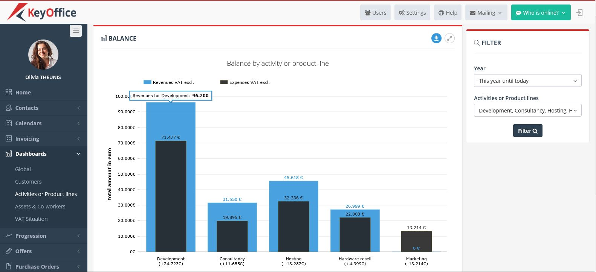
Analyze your revenues by activities of products
ANALYTICAL DASHBOARDS

Slide 10
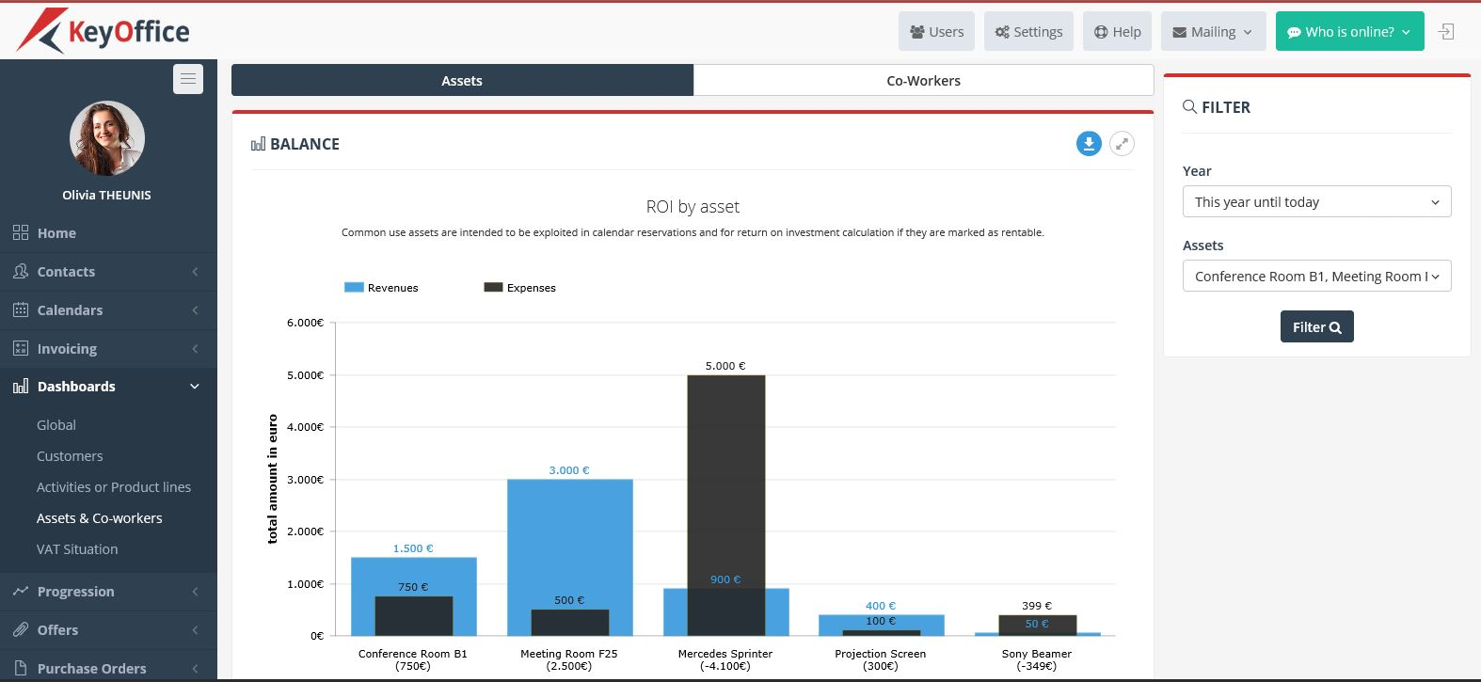
Follow your return on investments
ANALYTICAL DASHBOARDS

Slide 11
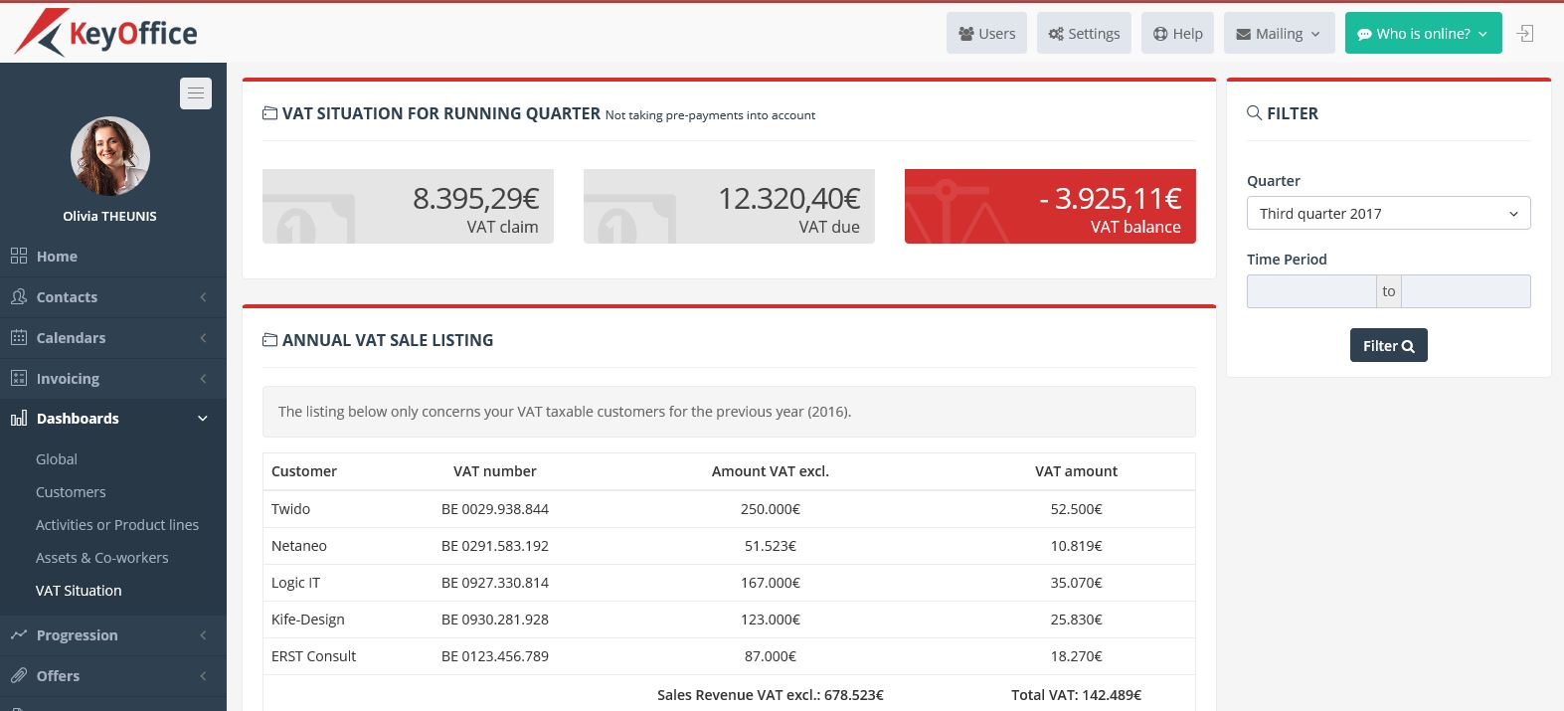
Overview your VAT situation
ACCOUNTING INFORMATION

Slide 12
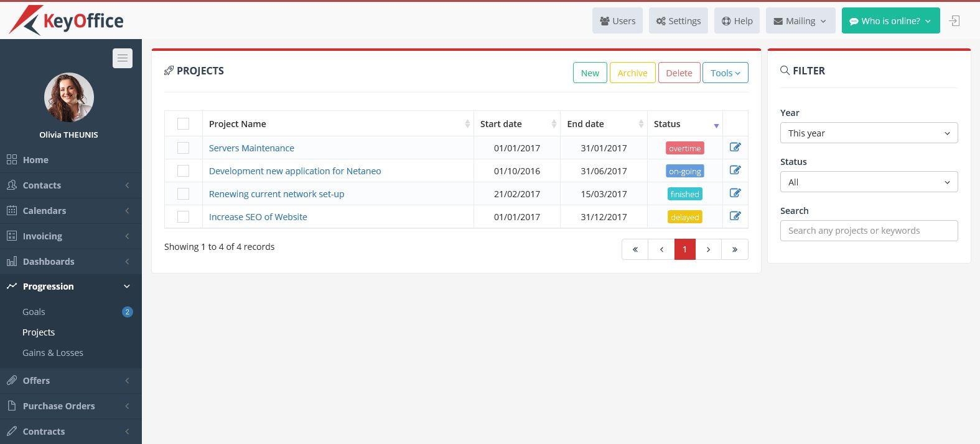
Follow-up your running projects and activities
SIMPLE PROJECT MANAGEMENT

Slide 13
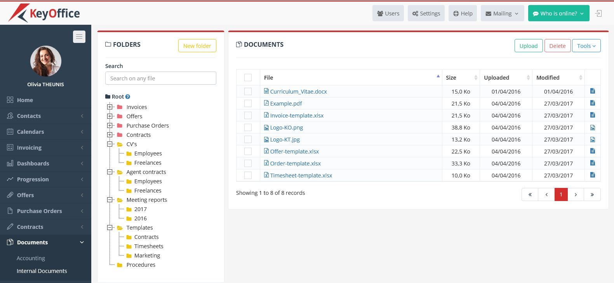
Organize all your documents
DAILY BACKUP of all your files and folders!
NEVER LOSE IMPORTANT DOCUMENTS ANYMORE

Slide 14
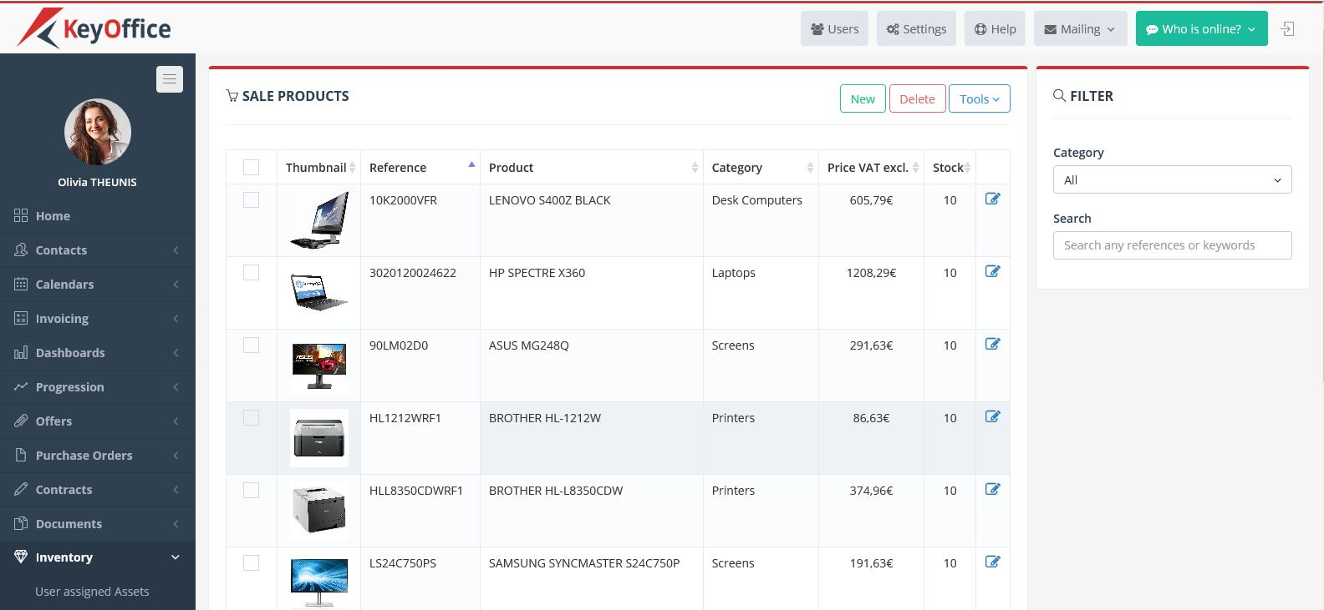
Get a clear view on all your assets
INVENTORY

